Slide 1
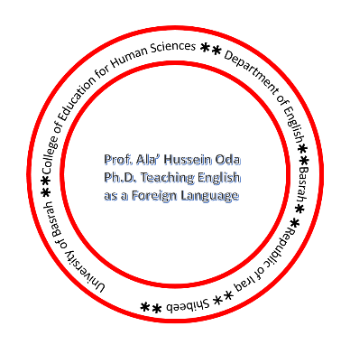
First Language Acquisition 3

Slide 2
The acquisition Process
child: My teacher holded the baby rabbits and we patted them.
mother: Did you say your teacher held the baby rabbits?
child: Yes.
mother: What did you say she did?
child: She holded the baby rabbits and we patted them.
mother: Did you say she held them tightly?
child: No, she holded them loosely

Slide 3
Developing morphology
By the time a child is two-and-a-half years old, he or she is going beyond
telegraphic speech forms and incorporating some of the inflectional morphemes
that indicate the grammatical function of the nouns and verbs used. The first to
appear is usually the -ing form in expressions such as cat sitting and mommy
reading book

Slide 4
The next morphological development is typically the marking of regular
plurals with the -s form, as in boys and cats. The acquisition of the plural
marker is often accompanied by a process of overgeneralization. The child
overgeneralizes the apparent rule of adding -s to formplurals and will talk about
foots and mans. When the alternative pronunciation of the plural morpheme used
in houses (i.e. ending in [-əz]) comes into use, it too is given an overgeneralized
application and forms such as boyses or footses can be heard

Slide 5
At the same time as
this overgeneralization is taking place, some children also begin using irregular
plurals such as men quite appropriately for a while, but then try out the general
rule on the forms, producing expressions like some mens and two feets, or even
two feetses. Not long after, the use of the possessive inflection -’s occurs in
expressions such as girl’s dog and Mummy’s book.

Slide 6
At about the same time, different forms of the verb ‘to be’, such as are and
was, begin to be used. The appearance of forms such as was and, at about the
same time, went and came should be noted. These are irregular past-tense forms
that we would not expect to hear before the more regular forms. However, they
do typically precede the appearance of the -ed inflection. Once the regular pasttense
forms (walked, played) begin appearing in the child’s speech, the irregular
forms may disappear for a while, replaced by overgeneralized versions such as
goed and comed.

Slide 7
Developing Syntax
Similar evidence against ‘imitation’ as the basis of the child’s speech production
has been found in studies of the syntactic structures used by young children.
One child, specifically asked to repeat what she heard, would listen to an adult
say forms such as the owl who eats candy runs fast and then repeat them in the
form owl eat candy and he run fast. It is clear that the child understands what
the adult is saying. She just has her own way of expressing it.

Slide 8
Forming Questions
In forming questions, the child’s first stage has two procedures. Simply add a
Wh-form(Where,Who) tothe beginning of the expression or utter the expression
with a rise in intonation towards the end, as in these examples:
Where kitty? Doggie?
Where horse go? Sit chair?

Slide 9
In the second stage, more complex expressions can be formed, but the rising
intonation strategy continues to be used. It is noticeable that more Wh-forms
come into use, as in these examples:
What book name? You want eat?
Why you smiling? See my doggie?

Slide 10
Forming Negatives
In the case of negatives, stage 1 seems to involve a simple strategy of putting
no or not at the beginning, as in these examples:
no mitten not a teddy bear no fall no sit there
In the second stage, the additional negative forms don’t and can’t appear, and
with no and not, are increasingly used in front of the verb rather than at the
beginning of the sentence, as in these examples:
He no bite you I don’t want it
That not mommy You can’t dance

Slide 11
Developing Semantics
The anecdotes that parents retell about their child’s early speech (to the intense
embarrassment of the grown-up child) usually involve examples of the strange
use of words. Having been warned that flies bring germs into the house, one
child was asked what “germs” were and the answer was “something the flies
play with”. It is not always possible to determine so precisely the meanings that
children attach to the words they use.

Slide 12
It seems that during the holophrastic stage many children use their limited
vocabulary to refer to a large number of unrelated objects. One child first used
bow-wow to refer to a dog and then to a fur piece with glass eyes, a set of
cufflinks and even a bath thermometer. The word bow-wow seemed to have a
meaning like ‘object with shiny bits’. Other children often extend bow-wow to
refer to cats, cows and horses

Slide 13
This process is called overextension and the most common pattern is for
the child to overextend the meaning of a word on the basis of similarities of
shape, sound and size, and, to a lesser extent, movement and texture. Thus the
word ball is extended to all kinds of round objects, including a lampshade, a
doorknob and the moon.

